Slide 1
Assignment # 1
ICT( Introduction to communication and Technology)

Slide 2
Components of Computer:
Input devices
Output devices
System unit
Storage devices
Communication devices

Slide 3
Input devices:
The data and instruction given to the computer is called input.
“A hardware component used to enter data and instruction into computer is called
Input device.”
For Example:
Keyboard
Mouse
Joystick

Slide 4
Output Devices
The data processed into useful information is called output.
“A hardware component used to display information to the user is called output device.”
For example:
Output devices
Monitor display
Speaker
Printer

Slide 5
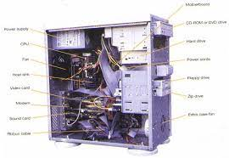
System Unit:
“System unit is a case that contains different electronic components of the computer used to process data.”
Fig:

Slide 6
Storage Devices:
“The hardware components used to store data, instructions and information permanently are called storage devices.”
For example:
Hard disk
Rom
Cd
Memory card
Ram

Slide 7
Communication Devices:
“The hardware components used to communicate and exchange data, instructions and information with other computers are called communication devices.”
For example:
Cell phone
Network card
Laptops
Wi-Fi devices
Bluetooth devices
Smart phone

Slide 8


